Slide 1
Safe Automatic Delivery - Alternative Design #3
Michael Sypa & Daniel Fee
EDD 104, Section 55

Slide 2

Agenda
Design Statement
Description
Introduction
Criteria
Conclusion

Slide 3
Design Statement
Design a toaster oven that will provide ease of use and safety for a blind person.

Slide 4
Description of the Alternative Design
Safe Automatic Delivery System
High Insulative Materials
Tilted Conveyor Belt Grill
Garage Door Film
Bluetooth Compatibility
Automatic Opening Door

Slide 5

Highly Insulative Materials and Low Thermal Conductivity
Silica Aerogel
0.02 W/mK at 25°C
Can withstand temperatures as high as 400°C
0.06 W/mK at 400°C
Notes:
When researching, I found that Silica Aerogel has a significantly low thermal conductivity meaning it barely transfers thermal energy or heat.

Slide 6
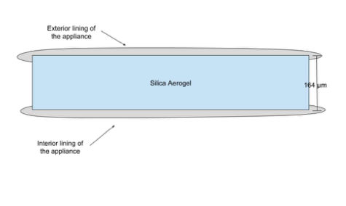
Notes:
So we are lining the outside with it to prevent the exterior from getting to hot.

Slide 7
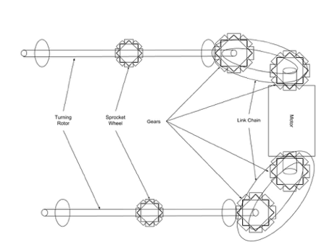
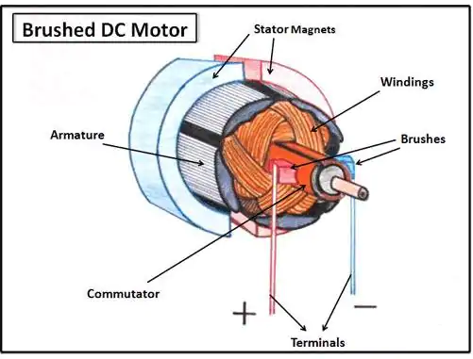
Conveyor Belt Grill
Grill made of stainless steel
Connected by two turning rotors that are
Moved by a DC-brush motor.
Controlled by Arduino
Notes:
Like a standard toaster oven, there will be a grill that the food can be placed on inside the appliance, it will be connected by two turning rotors that will be turned by a DC-brush motor. The appliance will utilize an Arduino in order to manipulate the current flow, thus control the timing of the device. The blind user can set the toaster oven to the desire cooking option, temperature and time. When the time is up, the conveyor grill will automatically activate for about 30 seconds in order to ensure that it makes it onto the automatic door.

Slide 8
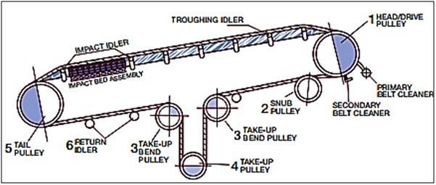
Tilted Aspect of Conveyor Grill
Automatic lowering at one end
Uses a system of pulleys
No gap between door and belt
Lowers at 10°

Slide 9
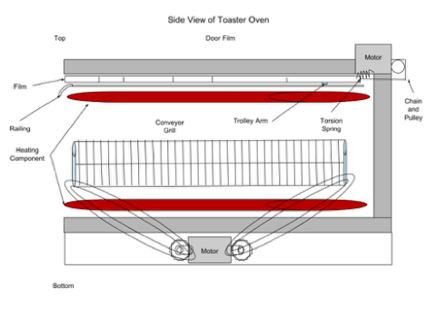
Garage Door Film
Made of thin sheet of aluminum
Controlled by chain drive motor system
Pulled on a small railing and torsion springs

Slide 10
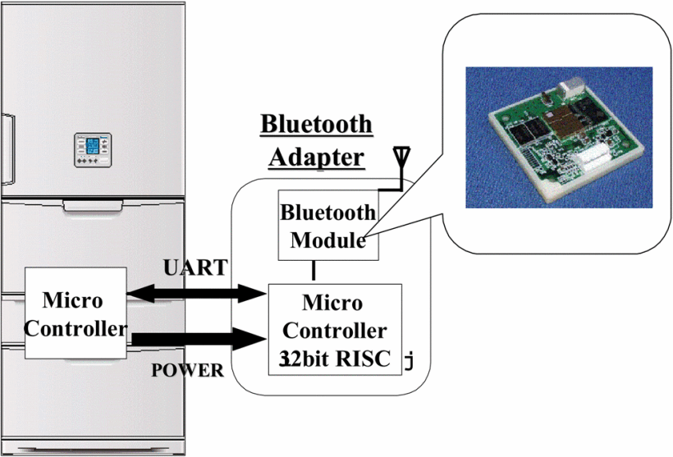
Bluetooth and Home Appliance Communication Adapter
Bluetooth microchip installed in toaster oven
UART technology
Phone app

Slide 11
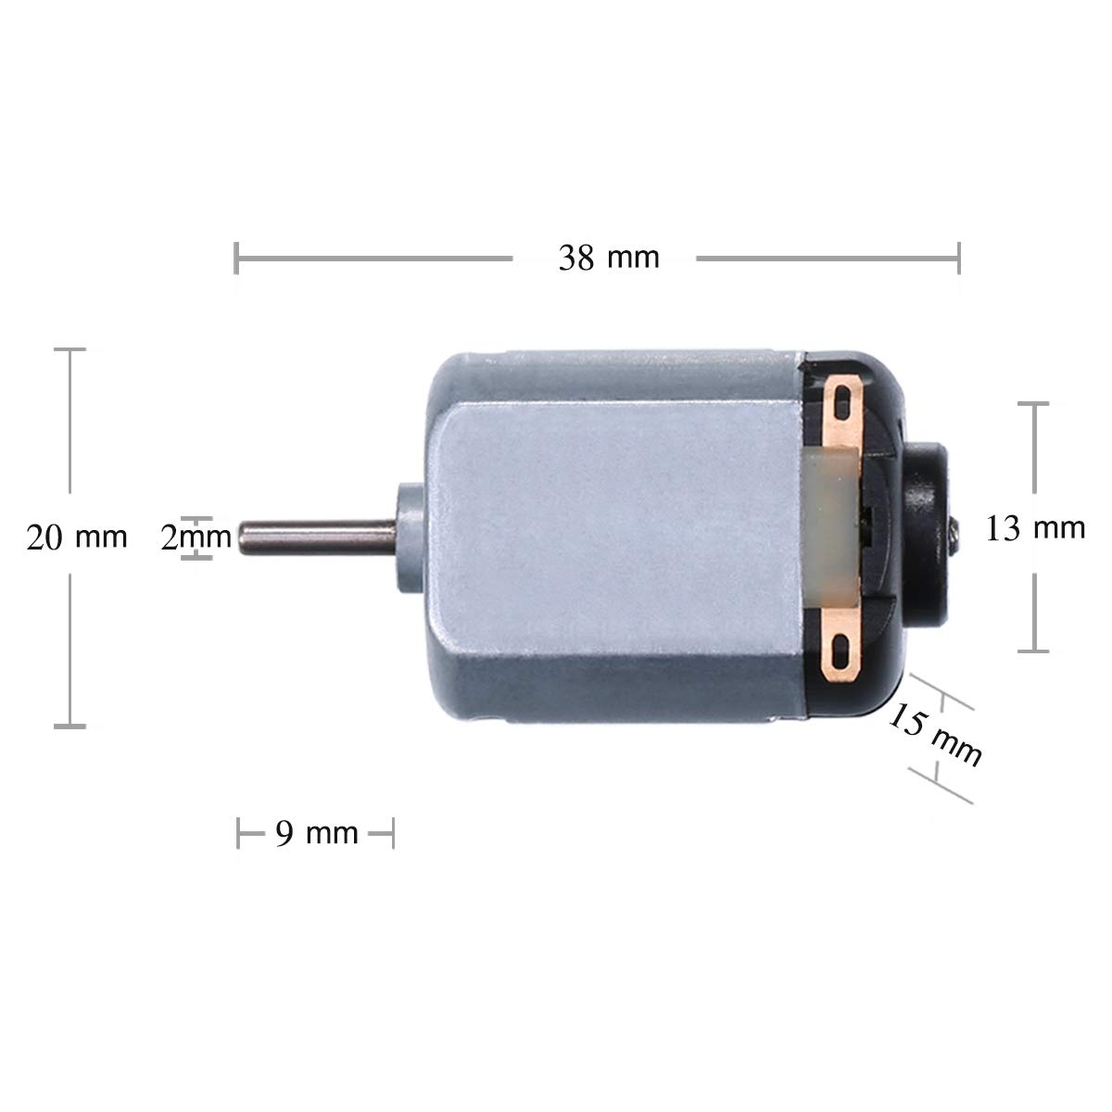
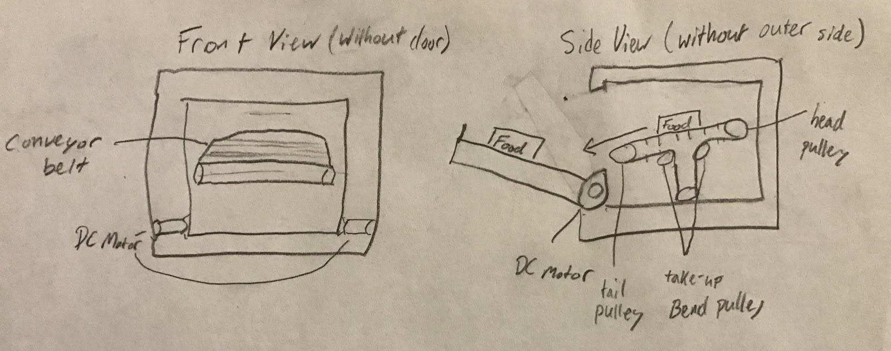
Automatic Door
Activated when timer stops
Controlled by DC motors
Low power system to comply with wattage allowance

Slide 12
Introduction of the Alternative Design
Solid Edge MATLAB

Slide 13
First Tier Requirements
[TFTB 1.1] The appliance shall be operational by the blind.
The knobs will be safe to touch labeled with Braille and the food will be easily accessed. Can be showed in Solid Edge.
[TFTB 1.2] The appliance shall be safe for the primary users.
Use high insulative materials like Silica Aerogel and deliver the food to the user.

Slide 14
First Tier Requirements
[TFTB 1.3] The appliance shall provide accessible controls to the users.
Simple, insulated control panel with Braille and Sound and Bluetooth notifications.
[TFTB 1.4] The appliance shall provide an assortment of food preparation choices. (just like a regular toaster oven)
Alternative design does not modify cooking functionality.

Slide 15
First Tier Requirements
[TFTB 1.5] The appliance shall abide by all applicable standards.
Basing our model off of a basic toaster oven.

Slide 16
Criteria Summaries Paul and Beitz
Structure (0.15)
Usability (0.25)
Performance (0.20)
Safety (0.30)
Cost (0.10)

Slide 17
Structure
[STR 2.1] The appliance shall provide enough room to fit an assortment of food choices. {TFTB 1.5}
Average sized dimensions, conveyor belt and extra motors do not interfere, can be shown in Solid Edge model
[STR 2.2] The appliance shall be structurally stable free of external supports. {TFTB 1.1 & 1.2}
Box shaped structure, sits on rubber feet can be shown in diagrams and Solid Edge.

Slide 18
Structure Contd.
[STR 2.3] The appliance opening shall have at least have one degree of freedom. {TFTB 1.3}
Automatic Door with motors that open from one end of the device can be shown in Solid Edge models
[STR 2.4] The appliance shall be made of durable materials. {TFTB 1.2}
Made of Aluminum and Stainless Steel that can withstand many years of use, can be verified by logical argument and research

Slide 19
Usability
[USE 2.1] The user shall be able to clean/maintain the appliance.
Crumb tray, grilling compartment with much open space for access
[USE 2.2] The user shall be able to select an operating temperature. {TFTB 1.3}
Knob with Braille, basic multi-cooking operations chosen with exterior buttons

Slide 20


Usability Contd.
[USE 2.3] The user shall be able to input time parameters for cooking. {TFTB 1.3}
Knob for time cook setting, many cooking options, can be shown in Solid Edge and diagrams.
[USE 2.4] The user shall have a user manual for instructions of operation. {TFTB 1.1 &1.3}
There will be an easy to understand user manual provided with purchase of the device. Can be verified by logical argument

Slide 21
Performance
[PERF 2.1] The appliance shall heat within the range of temperatures 130℉ to 500℉. {TFTB 1.4}
The Heating Component will have Nickel Chromate Alloy capable of reaching these temperatures, logical argument and calculations can be used.
[PERF 2.2] The appliance shall use an amount of power within the range of 600 to 1500 Watts when in use. {TFTB 1.5}
Wattage of low power DC motors, and Nichrome heating components are small and can be calculated.

Slide 22
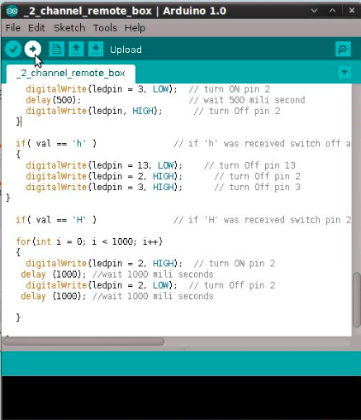
Performance Contd.
[PERF 2.3] The appliance shall provide feedback to the user about the status of operation. {TFTB 1.1, TFTB 1.3}
Sound and Bluetooth will alert user. MatLAB can be used to show how the Bluetooth code works.
[PERF 2.4] The appliance shall have an array of various cooking functions (just like a regular toaster oven). {TFTB 1.4}
The appliance will be able to carry out cooking processes of a normal toaster oven, logical argument can be used.

Slide 23
Safety
[SAFE 2.1] The appliance shall comply with NFPA 86 Section 11.5: Fire Protection for Class A Ovens. {TFTB 1.5}
There’s a fan and exhaust system like a standard toaster oven. Can be shown in Solid Edge.
[SAFE 2.2] The exterior materials of the appliance shall not exceed a temperature of 115℉. {TFTB 1.2}
The heat of the exterior will be safe to touch with the addition of Silica Aerogel which has a heat capacity of 0.06 W/mK at high temperatures. Can be calculated.

Slide 24
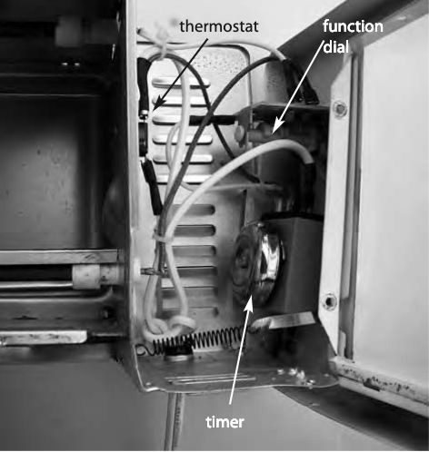
Safety Contd.
[SAFE 2.3] The appliance shall have a fail switch mechanism.
The appliance will have a thermostat and will shut off if toaster oven exceeds 500°F. Solid Edge model and diagrams could show that.

Slide 25
Cost
$5 for 4 small DC 3V motors
$2 for 14 x 8 in. tempered glass
$20 for heating component
$50 for aluminum
$10 for stainless steel
$17 for Silica Aerogel
$12 for Glass Door
$40 for Arduino and Electrical Components
Total= $156 for cost of materials

Slide 26
Conclusion
Key Modifications:
High Insulative Materials
Tilted Conveyor Belt Grill
Garage Door Film
Bluetooth Compatibility
Automatic Opening Door
Simplifies the process of using a toaster oven.
Protects against Burns
Satisfies all criteria and requirements

Slide 27
References
http://learn.linksprite.com/pcduino/pcduino-hardware-basic-and-improve/cell-phone-communicate-with-pcduino-via-bluetooth/
https://cdn3.iconfinder.com/data/icons/seo-glyph-2/24/task-512.png
https://web-b-ebscohost-com.proxy.binghamton.edu/ehost/ebookviewer/ebook/bmxlYmtfXzMyOTA0NF9fQU41?sid=775916f0-ce91-46d3-9fa1-7550c4021275@sessionmgr120&vid=0&format=EB&lpid=lp_171&rid=0
http://www.kice.com.sa/wp-content/uploads/2014/07/conveyor_GeneralLayout.png
http://i.ebayimg.com/images/i/161791836580-0-1/s-l1000.jpg
https://spinoff.nasa.gov/Spinoff2010/cg_2.html
https://www.mouser.com/applications/dont-ignore-the-brushed-dc-motor/

